Slide 1
Applied Data Science Capstone
Predicting Car Accident Severity
Sreeja Matturu

Slide 2
Introduction
Road accidents are one of the major categories where more than 38,000 people were dying due to many factors.
The main problem behind these road accidents in Seattle or any other city in the US is that the people do not know about the road conditions or sudden weather changes across some areas which are hard to predict

Slide 3
Problem
Building a model to predict the car accident severity using machine learning techniques. This model will help the professional drivers, commuters to reduce the impact of the major car accidents.

Slide 4
Data Collection
Data set called Data-Collisions.csv was collected from Kaggle.
Contains the information about Seattle car accidents information.
More than 190k rows and 37 columns.

Slide 5
Feature Selection
Collision
address type
The total number of people involved in the collision
The number of vehicles involved in the collision.
The date of the incident.
The date and time of the incident.
Category of junction at which collision took place.
Whether or not collision was due to inattention
The weather condition
The condition of the road
The light condition
Whether or not speeding was a factor in the collision

Slide 6
Machine Learning Techniques Used
K – Nearest Neighbor
Decision Tree
Logistic Regression

Slide 7
Evaluation Metrics
Jaccard index
F1- Score
LogLoss

Slide 8
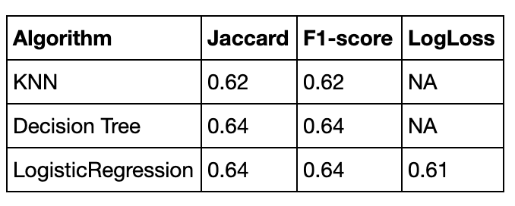
Results

Slide 9
Conclusion
Among the machine learning techniques used, Decision Tree performed the best.
Based on the evaluation metrics, it cannot be used to predict the car accident severity.
But the skate holders can make informed decision.

